Slide 1


HADHRI Achraf
LOPEZ-CHEFCHOUFI Célian
FOLTIER Tom
SCHACHTELE Damien

Slide 2

summary
Sentence pitch
Milestones
Diagramme de séquence
Use cases
Use case diagram
Architecture
Sequence diagram
Demo

Slide 3
Sentence pitch
Our company, Virtual Tag, is developing a new way of tagging that aims to project it into augmented reality to help tag artists into pursuing their art; while offering the possibility of selling their as nfts.

Slide 4

3 Milestones
- use the app only on certain monuments
- a pinterest lookalike with different building tags
- use on every building

Slide 5
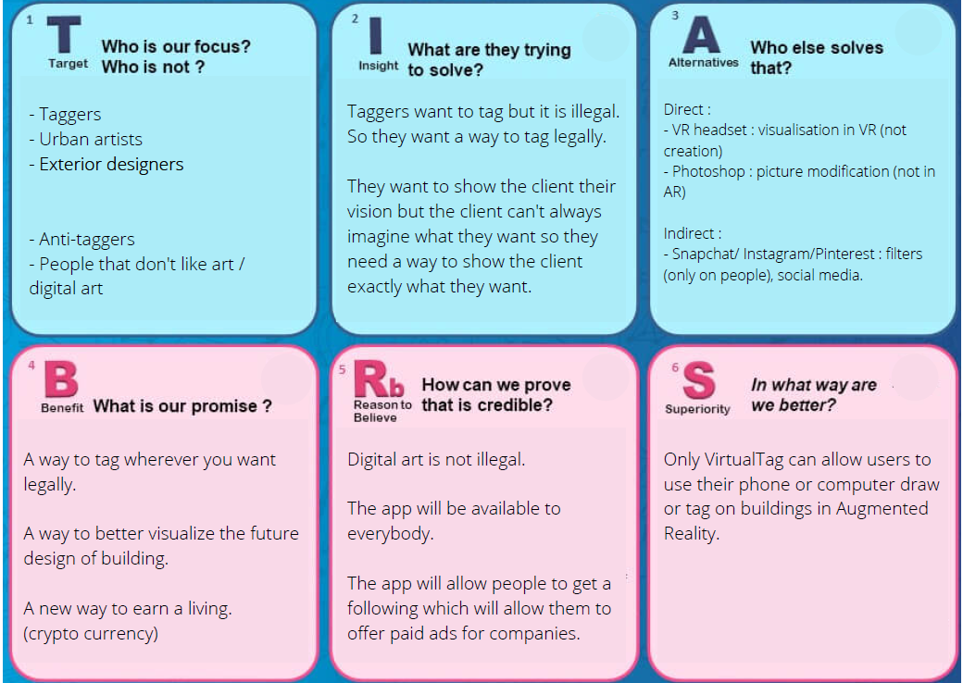
Tag artists are

Slide 6

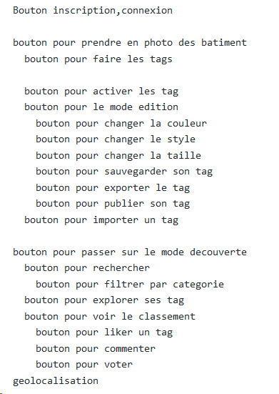
Use cases

Slide 7
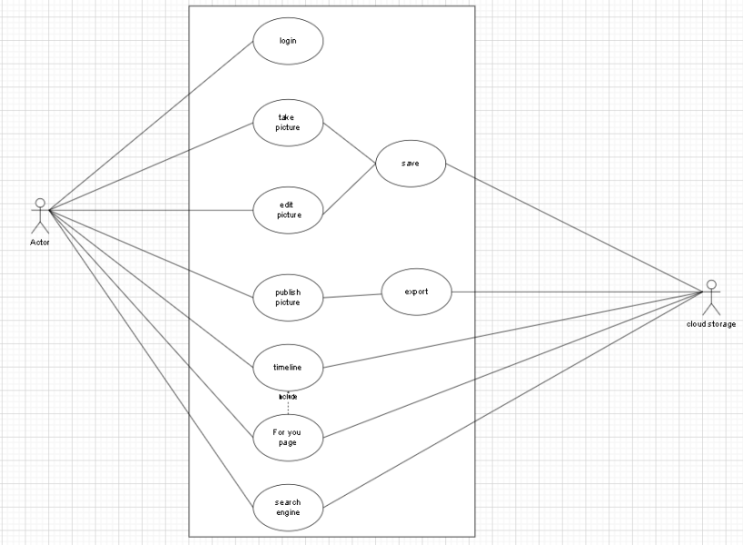
Use case diagram

Slide 8
Our architecture
We choose a Micro-service architecture because :
Micro-service allows
Agile development
Flexible deployment
Spread activities across team

Slide 9
Micro-service
Resilient
A micro-service must fail without impacting other services in the same application
Elastic
A micro-service must be able to scale -up or down-independently of other services in the same application

Slide 10
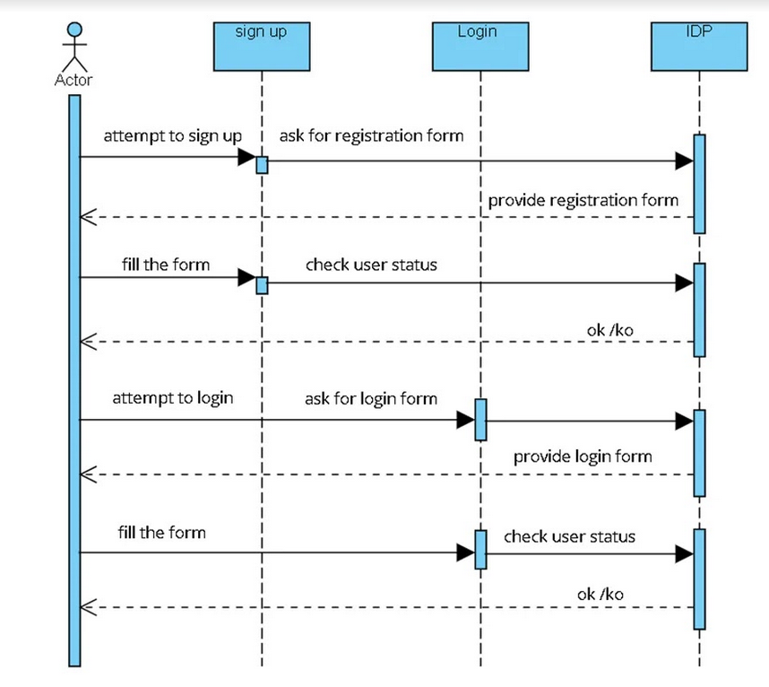
Sequence diagram registration/Authentification
Sign up/Registration
Login

Slide 11
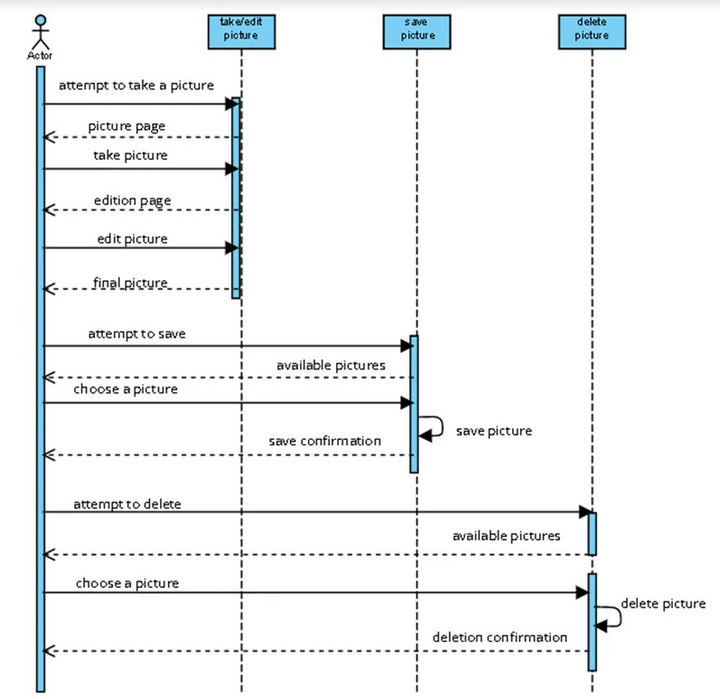
Sequence diagram
Take a picture
Save a photo
Delete a photo

Slide 12
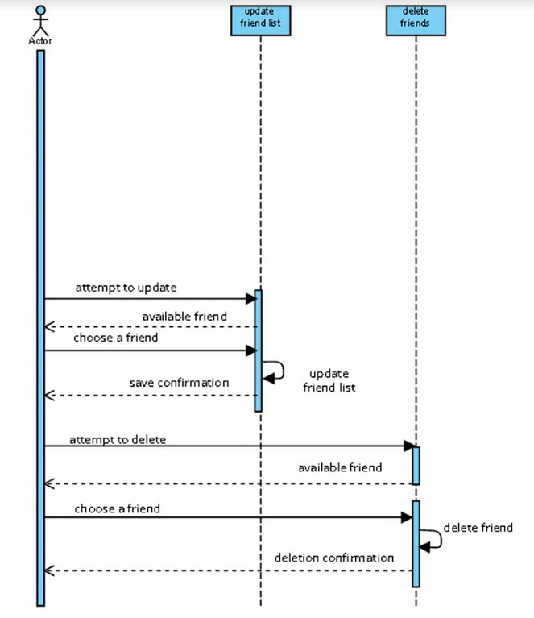
Sequence diagram
Add a friend
Update the list of friends
Save the list of friends
Delete a friend

Slide 13
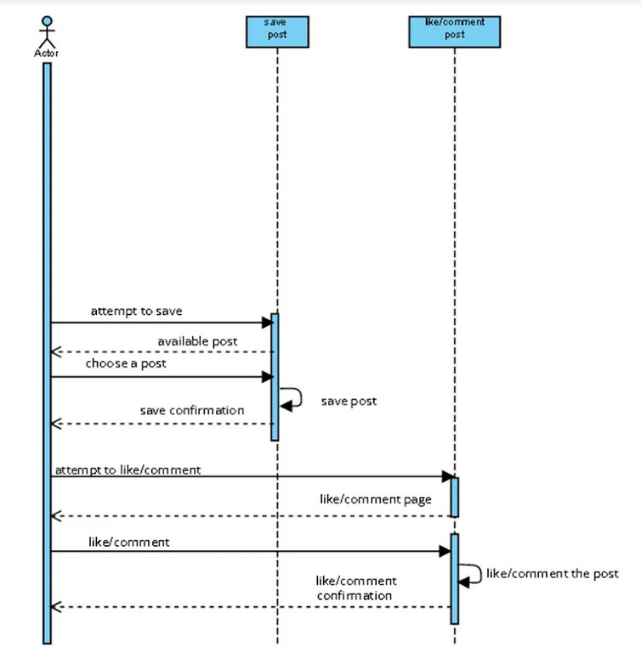
Sequence diagram
Choose a post
Save a post
Like/comment a post
Save like/comment

Slide 14
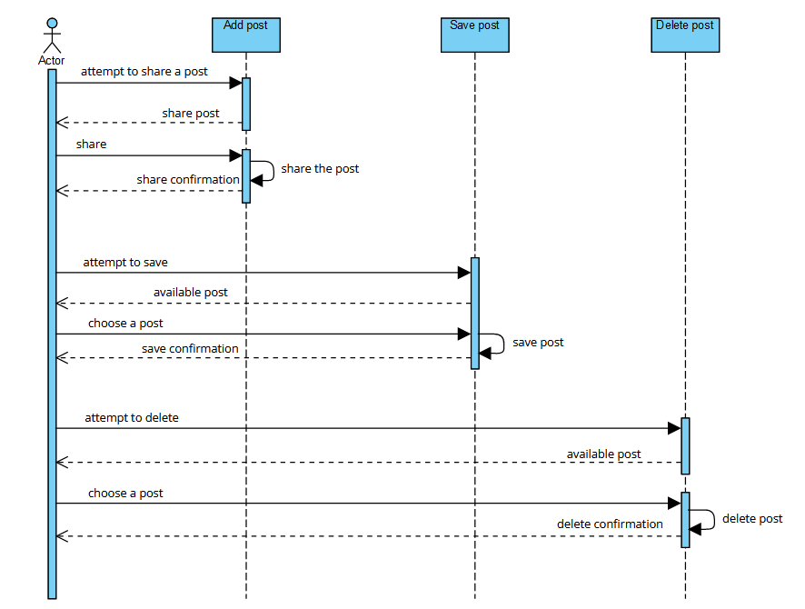
Sequence diagram
Add a post to share
Save a post
Delete a post

Slide 15
demo

Slide 16

Do you have any questions?
Thank you for your attention

